Slide 1
BIG MARKET SALES PREDICTION
CSE3020-DATA VISUALIZATION REVIEW-II
Made By:
-Naman Kapoor (18BCE0370)
-Adithya Yalagoud (18BCE0377)
-Prithiraj Bhuyan (18BCE2512)
SLOT: E1

Slide 2
objective
This project aims to build a predictive model and find out the sales of each product at a particular store and hence predict the sales of supermarket according to the sample supermarket dataset.
The idea is to find out the properties of a product, and store which impacts the sales of a product. Using this model, we will try to understand the properties of products and stores which play a key role in increasing sales
We’ve also used various visual plots between the data to better understand it.
Algorithms used to build our models are:
Linear Regression
Ridge Regression
Random Forest Regression

Slide 3
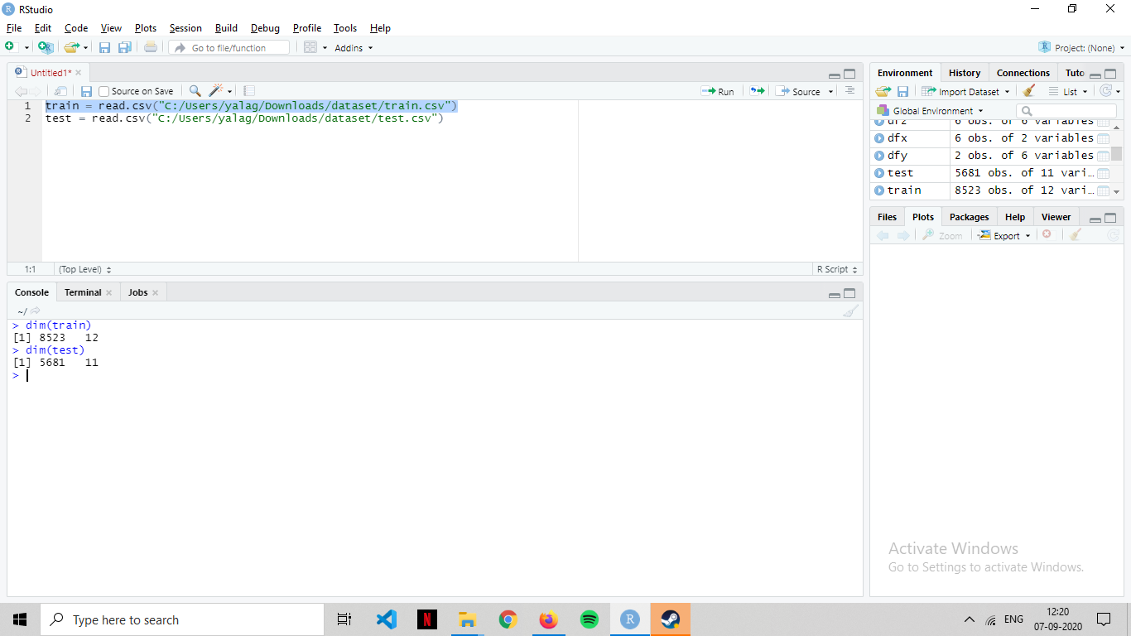
DATASET used
Big_Mart_Sales
Taken from Kaggle.com
The training set contains 8523 rows (instances) of 12 variables (attributes).
Testing set contains 5681 rows (instances) of 11 variables (attributes).
Data attributes : Item_Identifier, Item_Weight, Item_Type, Item_MRP, etc.

Slide 4
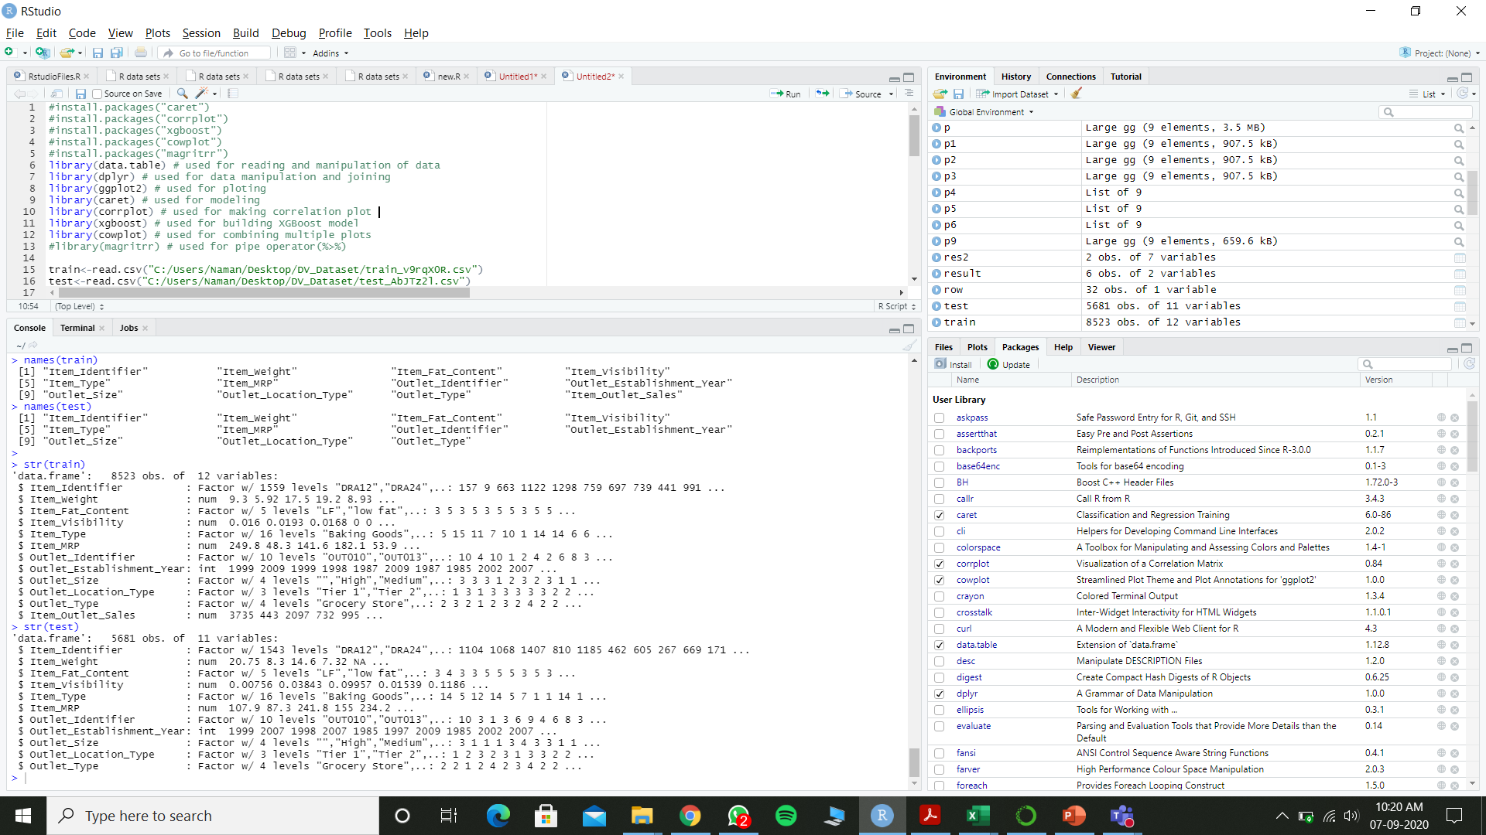

Slide 5
Packages/libraries used
#install.packages("caret")
#install.packages("corrplot")
#install.packages("xgboost")
#install.packages("cowplot")
#install.packages("magritrr")
library(data.table) # used for reading and manipulation of data
library(dplyr) # used for data manipulation and joining
library(ggplot2) # used for ploting
library(caret) # used for modeling
#library(corrplot) # used for making correlation plot
#library(xgboost) # used for building XGBoost model
#library(cowplot) # used for combining multiple plots

Slide 6
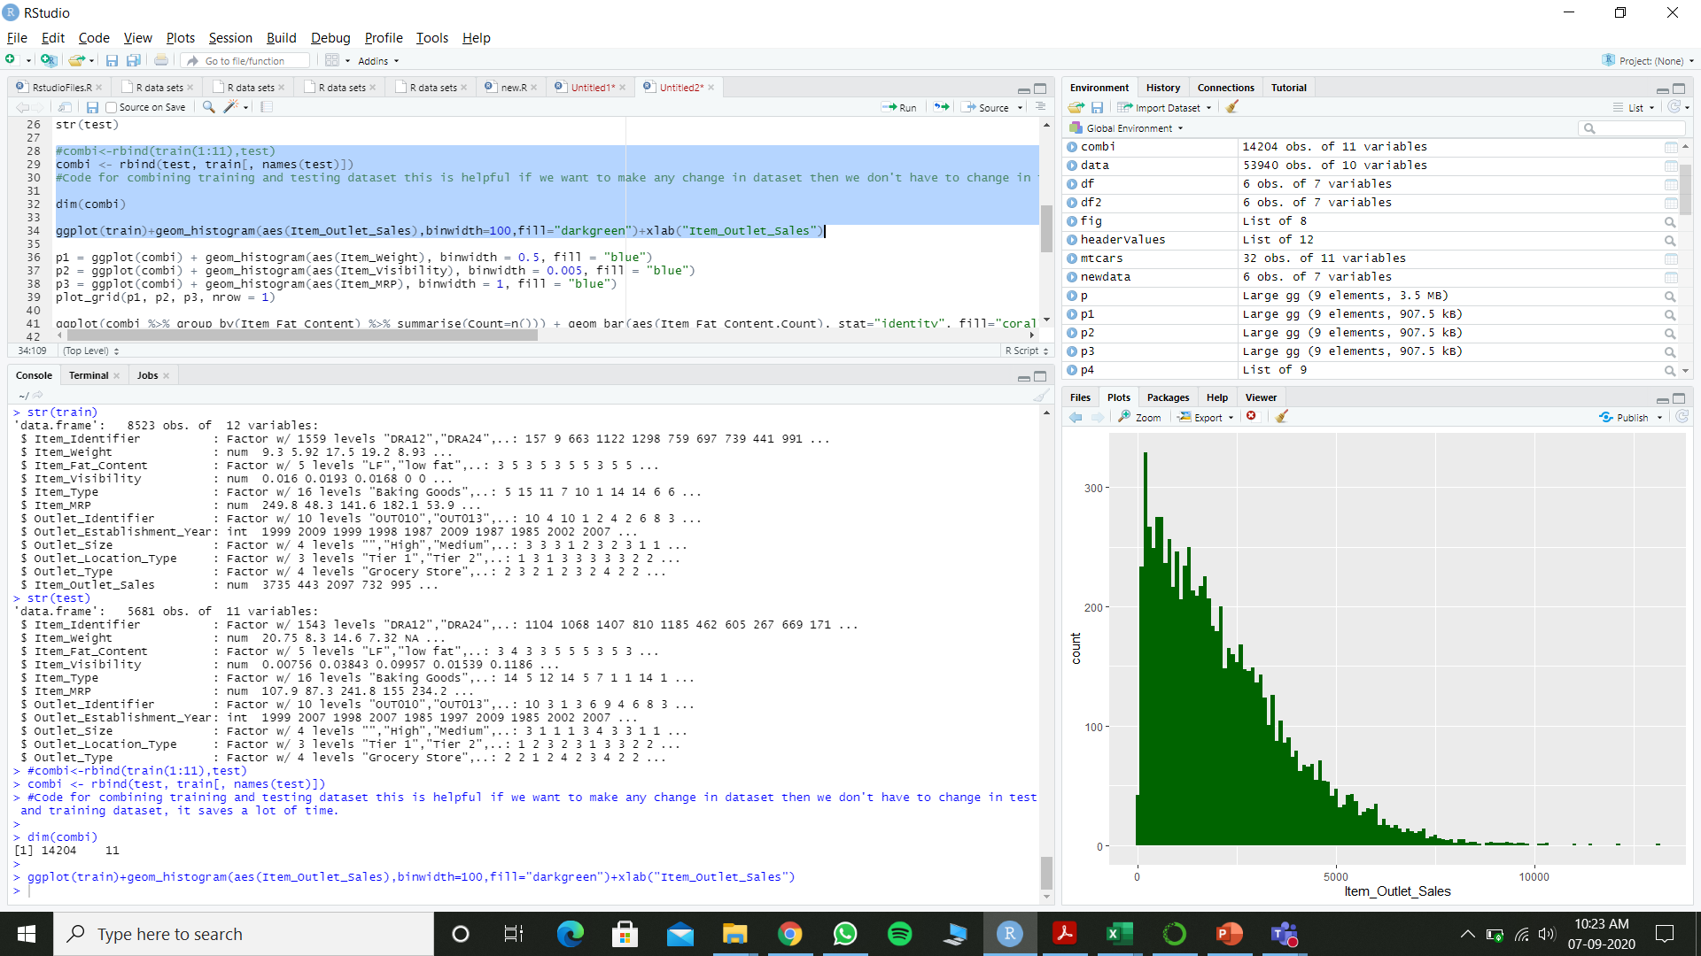
HISTOGRAM(GGPLOT2)-item_outlet_sales

Slide 7
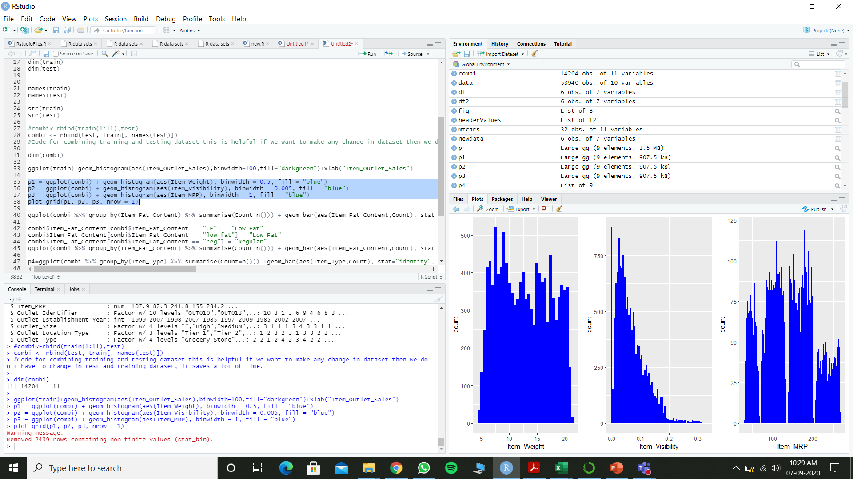
Histogram(cowplot)-item_weight, item_visibility, item_mrp

Slide 8
OBSERVATIONS:
No clear cut pattern in: Item_Weight, thus we get to know that it is randomly distributed.
Item_Visibility is right-skewed-thus must be transformed to curb skewness.
4 different distributions for Item_MRP, thus all the items are classified under 4 price ranges.

Slide 9
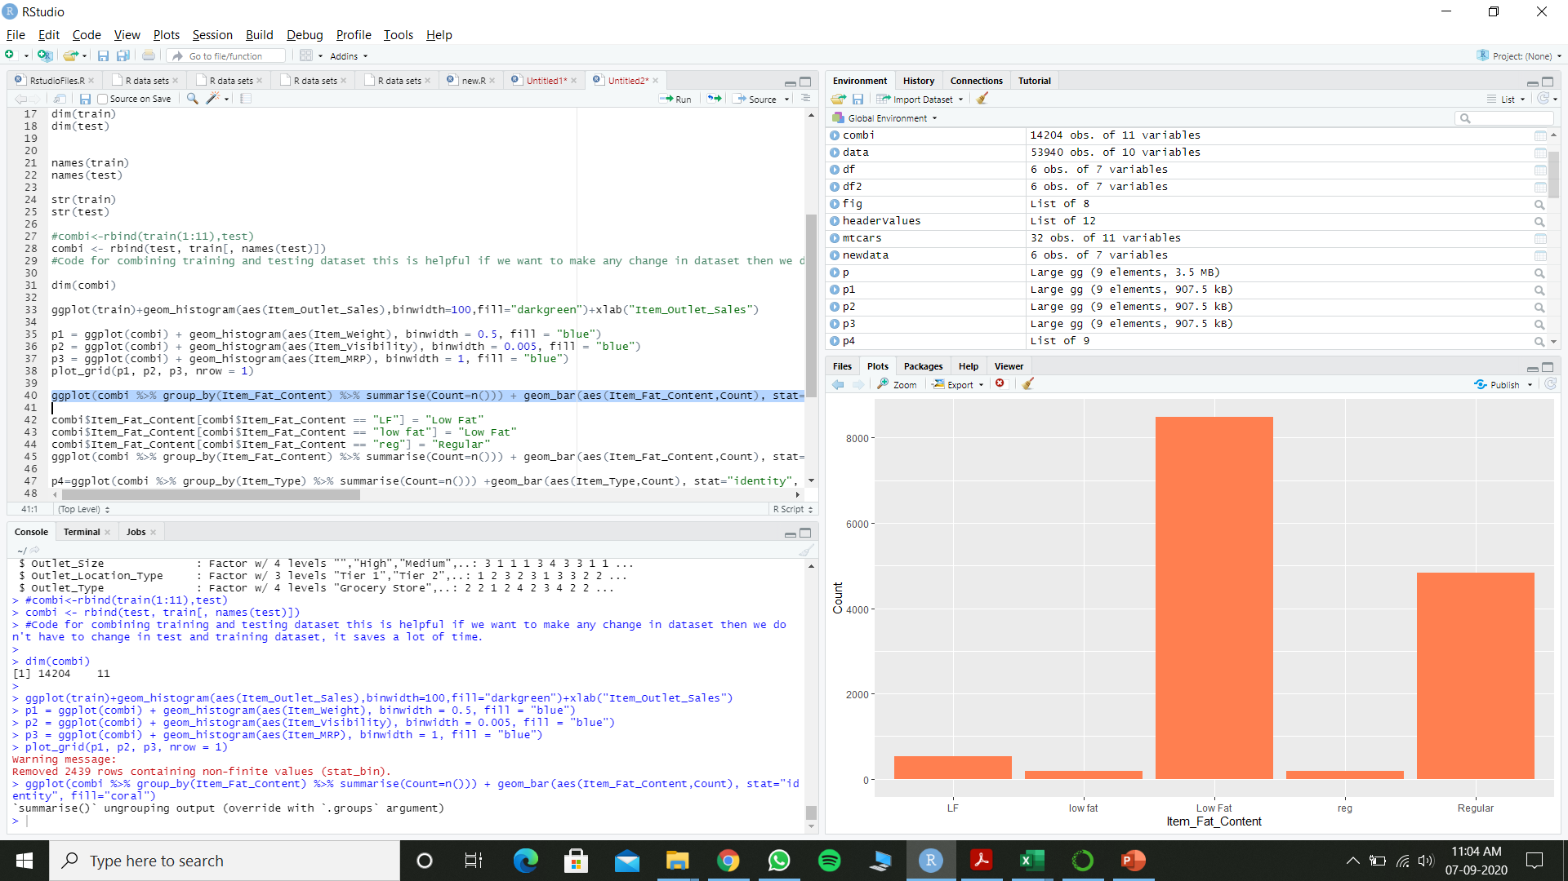
BAR graph(dplyr)-item_fat_content

Slide 10
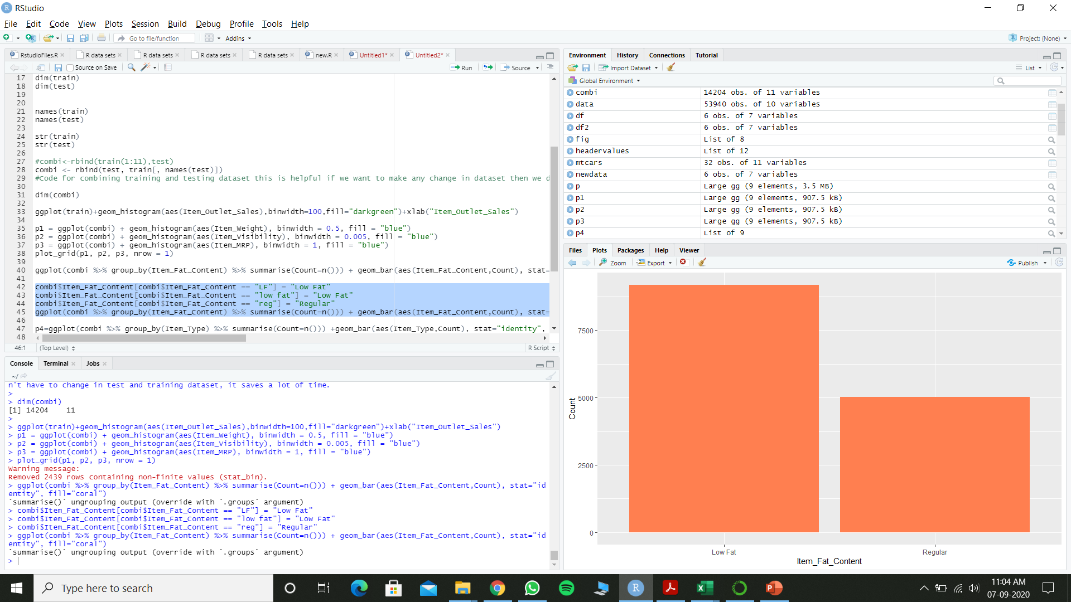
BAR graph-item_fat_content

Slide 11
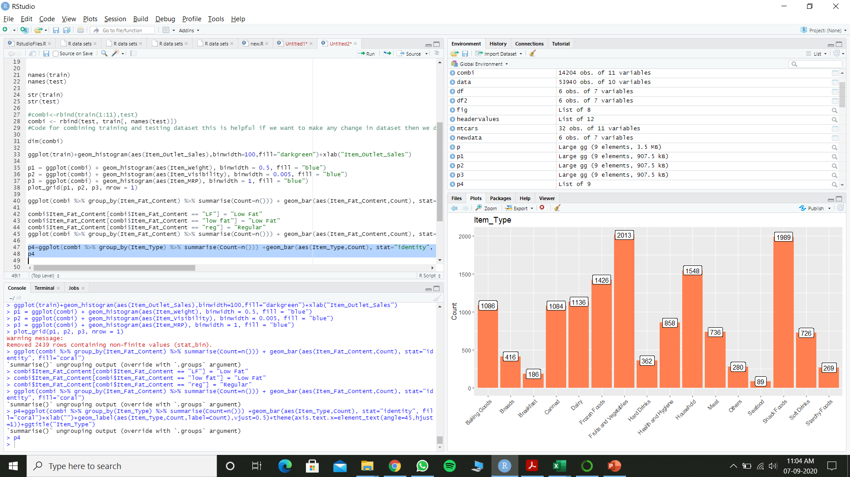
BAR graph-item_type

Slide 12
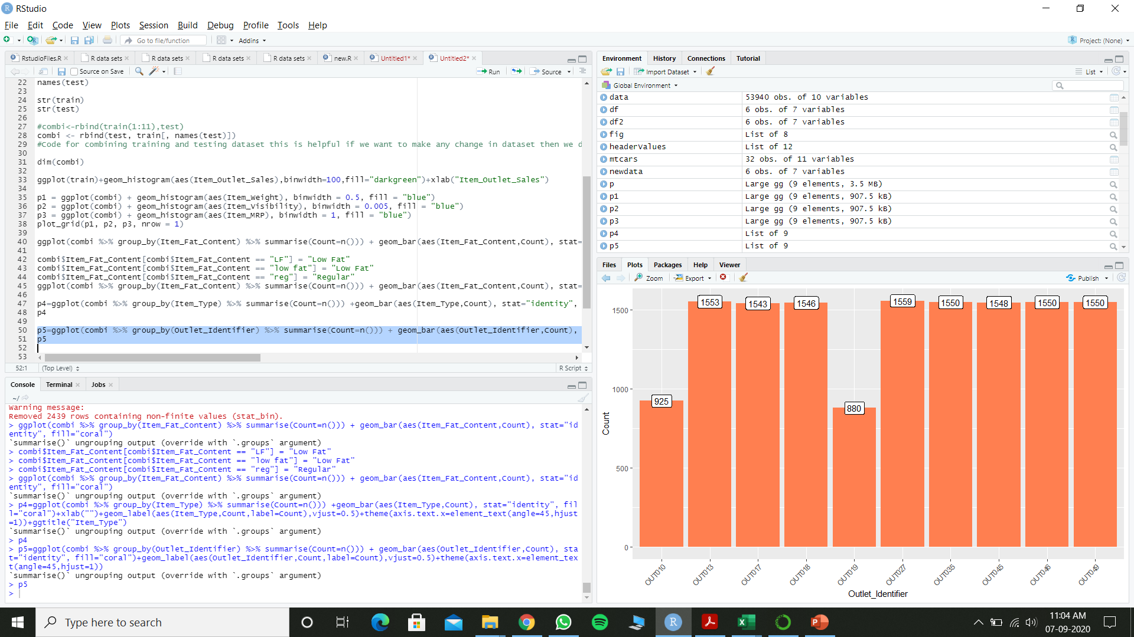
BAR graph-outlet_identifier

Slide 13
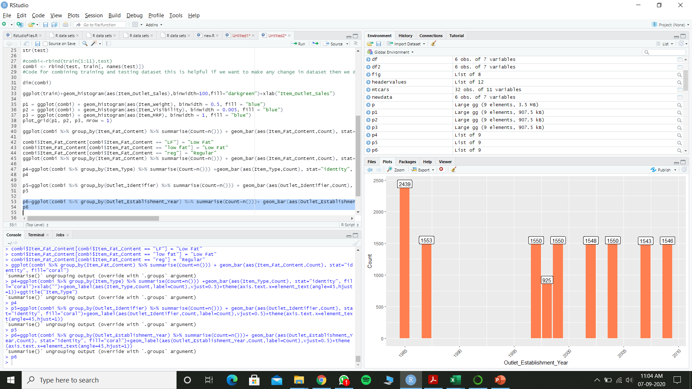
BAR graph-outlet_establishment_year

Slide 14
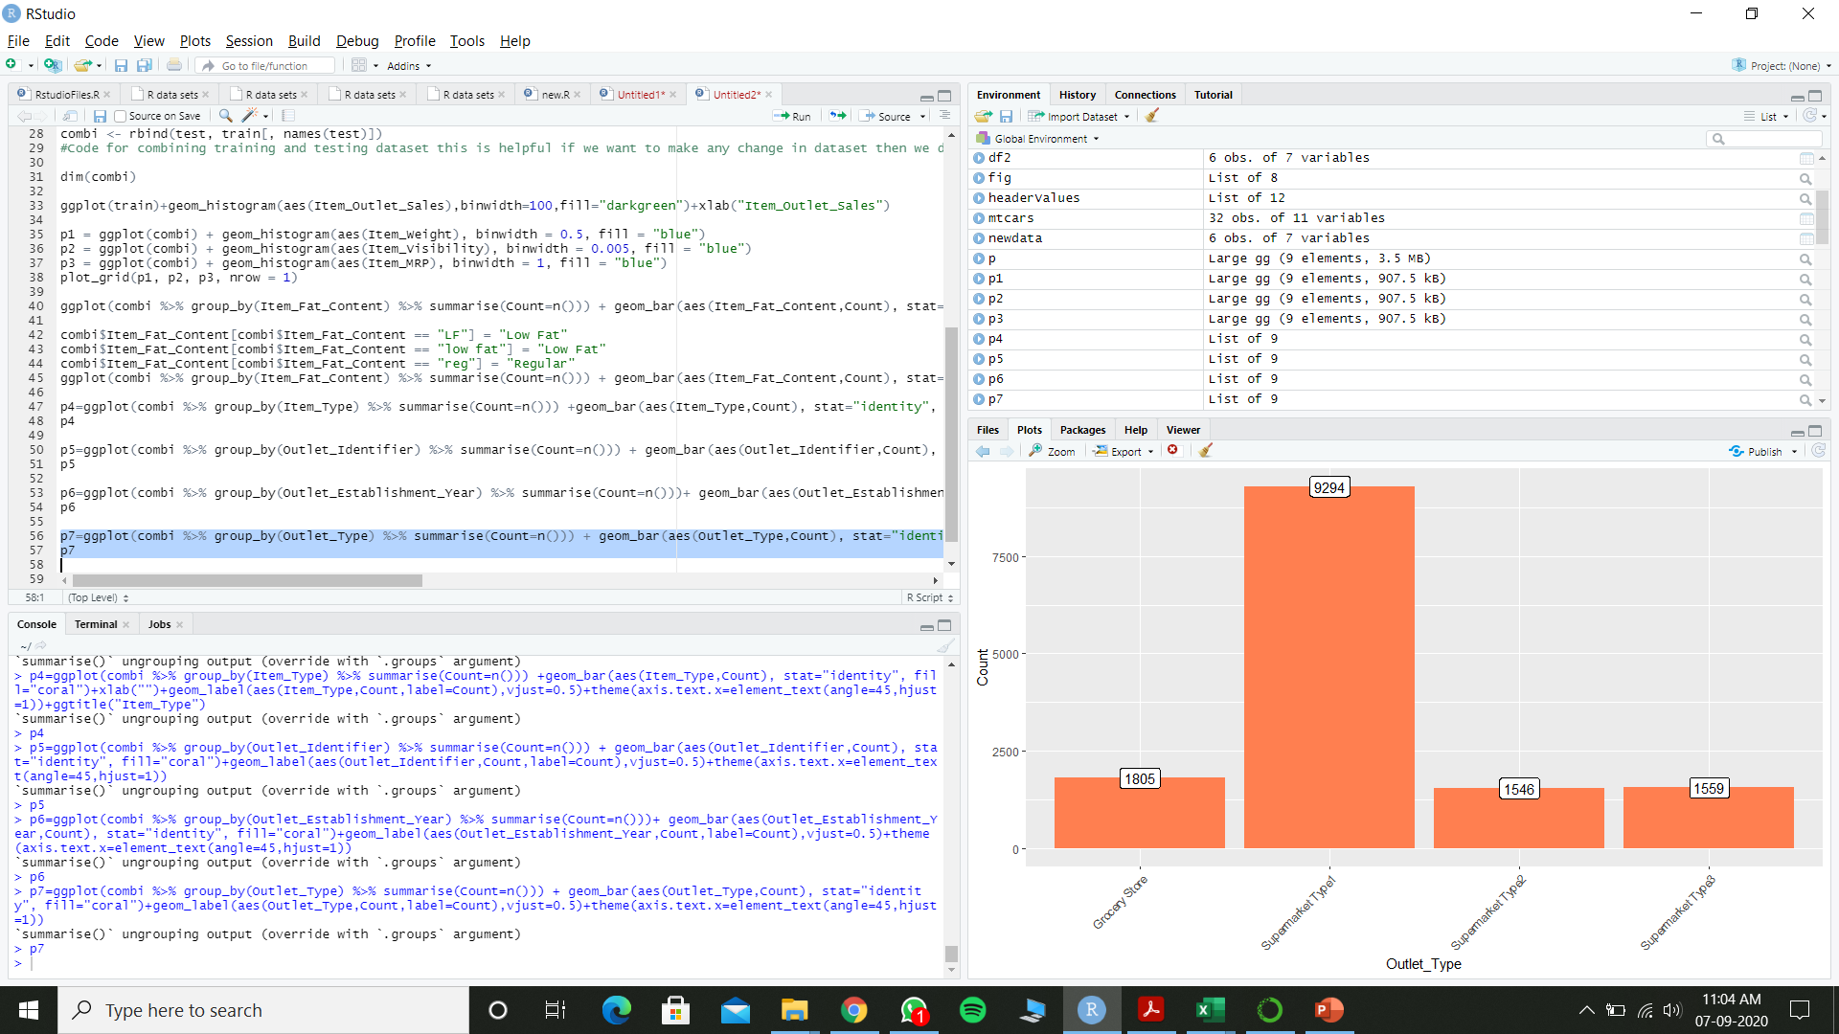

BAR graph-outlet_type
BAR graph-outlet_type

Slide 15
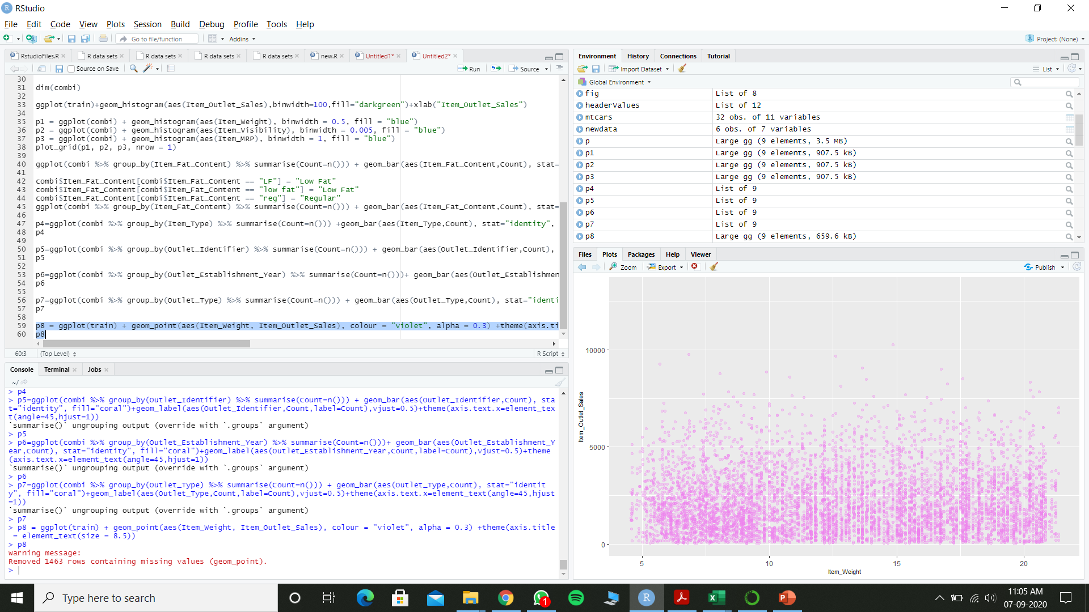
Scatter plot-item_weight

Slide 16
OBSERVATIONS:
Lesser number of observations in the data for the outlets established in the year 1998 as compared to the other years.
Supermarket Type 1 seems to be the most popular category of Outlet_Type.

Slide 17
MISSING VALUE HANDLING-
If there are any missing values in the dataset’s attributes, thus to make it work still, we have searched many ways to treat them based on the problem and the data. Some common techniques are as follows:
Deletion Of Rows-In train dataset, observations having missing values in any variable are deleted. The downside of this method is the loss of information and drop in prediction power of model.
Mean/Median/Mode Imputation-In case of continuous variable, missing values can be replaced with mean or median of all known values of that variable. For categorical variables, we can use mode of the given values to replace the missing values.
Building Prediction Model-We can even make a predictive model to impute missing data in a variable.
Here we will treat the variable having missing data as the target variable and the other variables as predictors.
We will divide our data into 2 datasets—one without any missing value for that variable and the other with missing values for that variable.
The former set would be used as training set to build the predictive model and it would then be applied to the latter set to predict the missing values.

Slide 18
TREATMENT-I:
There are missing values in Item_Weight and Item_Outlet_Sales, Item_Outlet_Sales can be ignored as they belong to the testing dataset. For Item_Weight, we’ll impute the missing ones with the mean weight on the Item_Identifier variable.
sum(is.na(combi$Item_Weight))
[1] 2439
missing_index=which(is.na(combi$Item_Weight))
> for(i in missing_index){
+ item=combi$Item_Identifier[i]
+ combi$Item_Weight[i]=mean(combi)
+ }

Slide 19
Thank you

